Slide 1
Why Not Grab a Free Lunch? Mining Large Corpora for Parallel Sentences to Improve Translation Modeling
Ferhan Ture and Jimmy Lin
University of Maryland, College Park
NAACL-HLT’12
June 6, 2012

Slide 2
Extracting Bilingual Text
Problem: Mine bitext from comparable corpora
Application: Improve quality of MT models
Approach:
Phase 1
Identify similar document pairs from comparable corpora
Phase 2
Generate candidate sentence pairs
Classify each candidate as ‘parallel’ or ‘not parallel’
Notes:
Approach → the standard approach

Slide 3
Extracting Bilingual Text
“No Free Lunch: Brute Force vs.
Locality-Sensitive Hashing for Cross-lingual Pairwise Similarity”. Ture et al. SIGIR 2011.
source-language
collection F
Phase 1
1.5m German Wikipedia articles
64m
German-English
article pairs
docvectors_{F}
Signature Generation
cross-lingual
document pairs
target-language
collection E
3.5m English Wikipedia articles
docvectors_{E}
Signature Generation
Phase 2
aligned
bilingual
sentence
pairs
candidate
sentence pairs
2-step
Classifier
Candidate Generation
Notes:
Wikipedia reason = largest available
Say Based on LSH

Slide 4
Extracting Bilingual Text
Challenge:
64m document pairs → hundreds of billions sentence pairs
Solution:
2-step classification approach
a simple classifier efficiently filters out irrelevant pairs
a complex classifier effectively classifies remaining pairs

Slide 5
Related Work
Extracting bitext from web pages (Resnik&Smith’03), news stories (Munteanu&Marcu’05), and Wikipedia articles (Smith et al’10).
no heuristics on document/time structure (i.e., generalizable)
scalable implementation
Recent Google paper with similar motivation (Uszkoreit et al’10)
far less computational resources
control “efficiency vs effectiveness”
not simply “more data is better”
significant results with much less data
Notes:
Top three papers use heuristics: structural, temporal, interwiki links
Google: 2000 state of the art machines
Generalizable → No heuristics, approximate N^2
+ based on LSH

Slide 6
Bitext Classifier
Features
cosine similarity of the two sentences s₁ and s₂
where u₁ and u₂ are vector representations of s₁ and s₂
sentence length ratio: the ratio of lengths of the two sentences
word translation ratio: ratio of words in s₁ that have translations in s₂, (only consider translations with at least 0.01 probability)
Notes:
Maxent = logistic regression, does not assume independence between features

Slide 7
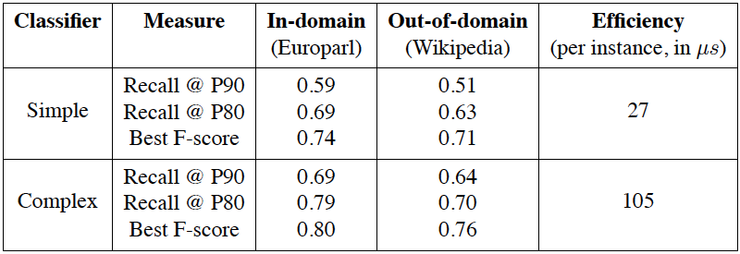
Bitext Classifier
Evaluation
comparable with
Smith et al’10
Maximum entropy classifier (OpenNLP-MaxEnt)
Europarl v6 German-English corpus
Trained on1000 parallel, 5000 non-parallel (sampled from all possible)
Tested on 1000 parallel, 999000 non-parallel (all possible)
good out-of-domain
performance
4 times faster

Slide 8
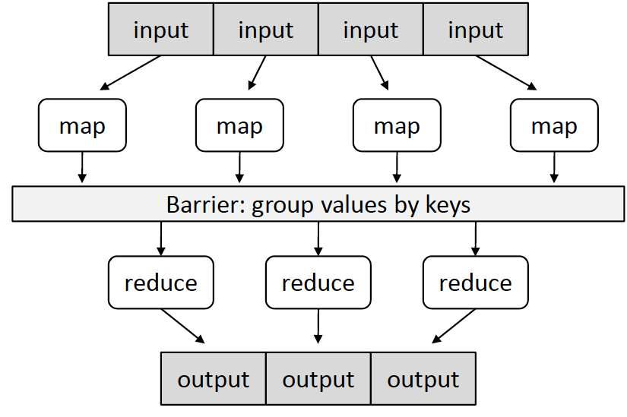
MapReduce
Easy-to-understand programming model for designing scalable and distributed algorithms
Experiments on Hadoop cluster
12 nodes, each with 2 quad-core 2.2GHz Intel processors, 24 GB RAM

Slide 9
Bitext Extraction Algorithm
cross-lingual
document pairs (n_{e},n_{f})
candidate
generation
2.4 hours
sentences and
sent. vectors
sentence detection+tf-idf
({s_{e}},{v_{e}})
({s_{f}},{v_{f}})
({s_{e}}’,{v_{e}}’)
({s_{f}}’,{v_{f}}’)
source (n_{e} , d_{e})
target (n_{f} , d_{f})
shuffle&sort
1.25 hours
MAP < n_{e} , d_{e} > ↦ < (n_{e} , n_{f}) , ({s_{e}}’,{v_{e}}’) >
cartesian
product
REDUCE < (n_{e} , n_{f}) , ({s_{e}}’,{v_{e}}’,{s_{f}}’,{v_{f}}’) > ↦ <(n_{e} , n_{f}) , (s_{e} , s_{f})>
X
complex classification
0.52 hours
{v_{e},v_{f})}
simple classification
4.13 hours
simple classification
{(v_{e},v_{f})’}
bitext S₂
complex
classification
bitext S₁
Notes:
Notice that for each doc pair, we emit the sentences in an article through the network, which produces a lot of redundant traffic.
Alternative implementation that minimizes this redundancy = group all similar target articles to a given source article and emit all together.
This turns out much much slower due to load imbalance (4% of src articles have more than 100 links, while half have none) --- an interesting observation

Slide 10
Evaluation on MT
Train with GIZA++, Hiero-style SCFG
Tune with MIRA on WMT10 development set (2525 sentences)
Decode with cdec (2489 sentences) using 5-gram English LM (SRILM)
Baseline system
all standard cdec features
21.37 BLEU on test set
5th out of 9 WMT10 teams with comparable results
best teams use novel techniques to exploit specific aspects
→ strong and competitive baseline
Notes:
5th out of 9 => would’ve been

Slide 11
End-to-End Experiments
Candidate generation
64 million German-English article pairs from phase 1
400 billion candidate sentence pairs
214 billion after (# terms ≥ 3 and sentence length ≥ 5)
132 billion after (1/2 < sentence length ratio < 2)
random sampling
WMT10 train
simple > 0.98
complex > 0.60
2-step
complex > 0.65
WMT10 train
simple > 0.986
1-step
simple > 0.992
data size
(in millions)
0
3.1
5.3
8.1
16.9
Notes:
Tuned on tuning and testing sets provided for wmt10 = 2525 tune, 2489 test. MIRA for tuning.
Ranked 5th out of 9 participants in wmt10 that reported comparable results
----- Meeting Notes (4/19/12 18:32) -----
add 1-step, 2-step on the two rows

Slide 12
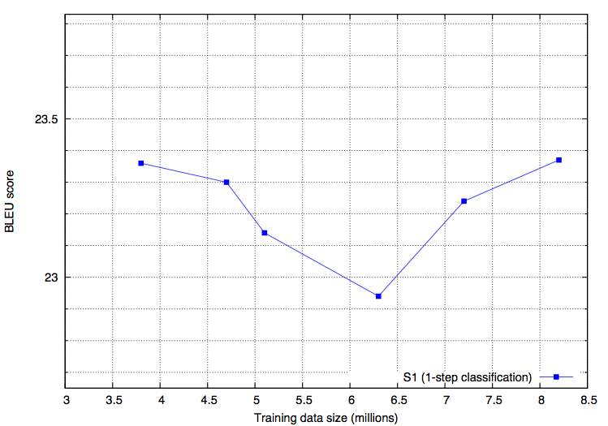
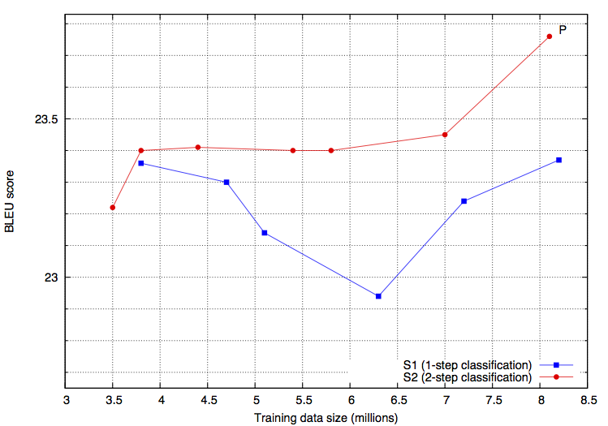
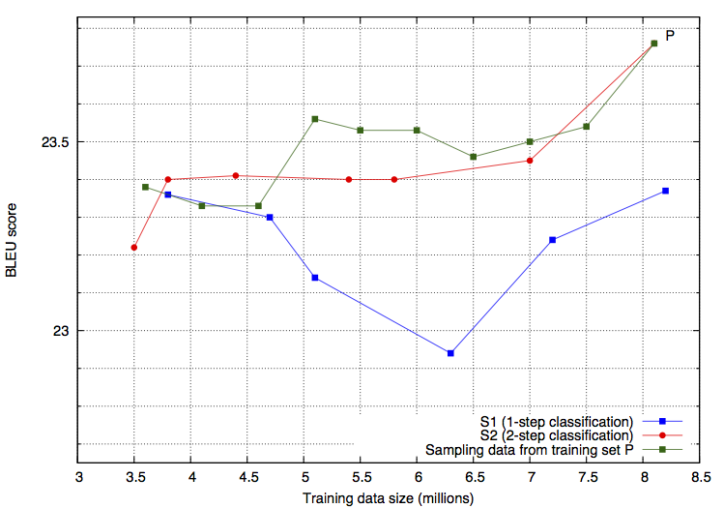
Evaluation on MT
S₂>S₁ consistently
random > S₂
when low-scoring
sentence pairs
may be helpful in
MT
turning point
when the benefits
of more data
exceeds the extra
noise introduced
2.39 BLEU improvement
over baseline
Baseline = 21.37
Notes:
Add baseline number somewhere
Highest we know reported on this test set
Animate the lines: s1, s1+s2, s1+s2+random

Slide 13
Conclusions
Built approach to extract parallel sentences from freely available resources
5m sentence pairs → highest BLEU in WMT’10
data-driven > task-specific engineering
Why not grab a free lunch?
We plan to extend to more language pairs and share our findings with the community
All of our code and data is freely available

Slide 14
Thank you!
Code: ivory.cc
Data: www.github.com/ferhanture/WikiBitext

Slide 15
Algorithm Design
Reduce-side join in MapReduce where (d_{e} , d_{f}) serves as join key
Sentences are emitted multiple times, one for each (d_{e} , d_{f}) pair:
increased network traffic during the shuffle/sort phase.
Alternative: group together all d_{e} similar to some d_{f}
much slower despite reduced network traffic, due to skew in the distribution of similar document pairs
half of the source collection was not linked to any target document, 4% had more than 100 links each.
load imbalance on reducers → “stragglers” increase total runtime
Notes:
Notice that for each doc pair, we emit the sentences in an article through the network, which produces a lot of redundant traffic.
Alternative implementation that minimizes this redundancy = group all similar target articles to a given source article and emit all together.
This turns out much much slower due to load imbalance (4% of src articles have more than 100 links, while half have none) --- an interesting observation

