Slide 1
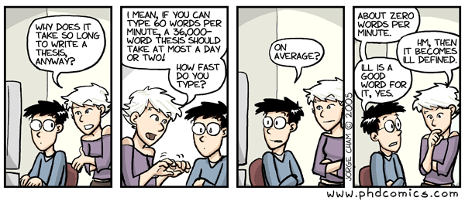

Slide 2

“Searching to Translate”, and
“Translating to Search”:
When Information Retrieval Meets Machine Translation
Ferhan Ture
Dissertation defense
May 24th, 2013
Department of Computer Science
University of Maryland at College Park

Slide 3
Motivation
Fact 1: People want to access information
  e.g., web pages, videos, restaurants, products, …
Fact 2: Lots of data out there
  … but also lots of noise, redundancy, different languages
Goal: Find ways to efficiently and effectively
  Search complex, noisy data
  Deliver content in appropriate form
  forum posts
  multi-lingual text
  clustered summaries
  user’s native language

Slide 4
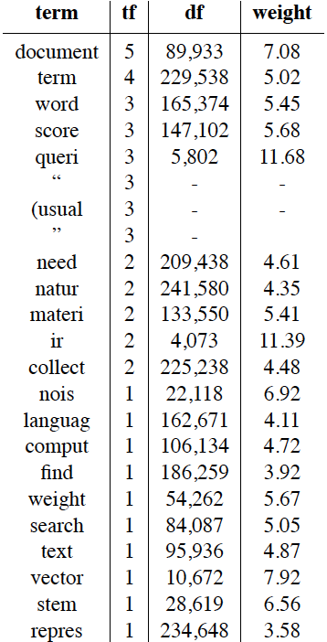
Information Retrieval
Information retrieval (IR) is finding material (usually documents) of an unstructured nature (usually text) that satisfies an information need from within large collections (usually stored on computers). In our work, we assume that the material is a collection of documents written in natural language, and the information need is provided in the form of a query, ranging from a few words to an entire document. A typical approach in IR is to represent each document as a vector of weighted terms, where a term usually means either a word or its stem. A pre-determined list of stop words (e.g., ``the'', ``an'', ``my'') may be removed from the set of terms, since they have found to create noise in the search process. Documents are scored, relative to the query, usually by scoring each query term independently and aggregating these term-document scores.
queri:11.69,
ir:11.39,
vector:7.93,
document:7.09,
nois:6.92,
stem:6.56,
score:5.68,
weight:5.67,
word:5.46,
materi:5.42,
search:5.06,
term:5.03,
text:4.87,
comput:4.73,
need:4.61,
collect:4.48,
natur:4.36,
languag:4.12,
find:3.92,
repres:3.58
retriev ir find materi (usual document unstructur natur (usual text satisfi need larg collect (usual store comput work assum materi collect document written natur languag need form queri rang word entir document typic approach ir repres document vector weight term term mean word stem pre-determin list word .g. `` '' `` '' `` '' may remov set term found creat nois search process document score relat queri score queri term independ aggreg term-docu score
Notes:
A simpler model of language, that emphasizes on content and ignores most of the structure. We trade off the more complex repreesntation and structure for efficiency. A document is represented by a vector of terms and corr. Weights, which can be processed very efficiently
e.g., the term stop in stop word shouldn’t be removed if we know that it precedes word (and therefore has a different useful sense)
This process is called the tf-idf model

Slide 5
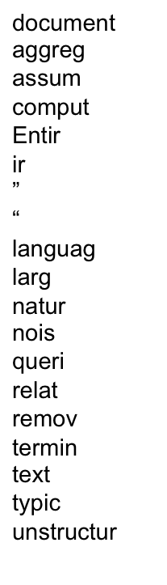
Cross-Language Information Retrieval
Information Retrieval (IR) bzw. Informationsrückgewinnung, gelegentlich ungenau Informationsbeschaffung, ist ein Fachgebiet, das sich mit computergestütztem Suchen nach komplexen Inhalten (also z. B. keine Einzelwörter) beschäftigt und in die Bereiche Informationswissenschaft, Informatik und Computerlinguistik fällt. Wie aus der Wortbedeutung von retrieval (deutsch Abruf, Wiederherstellung) hervorgeht, sind komplexe Texte oder Bilddaten, die in großen Datenbanken gespeichert werden, für Außenstehende zunächst nicht zugänglich oder abrufbar. Beim Information Retrieval geht es darum bestehende Informationen aufzufinden, nicht neue Strukturen zu entdecken (wie beim Knowledge Discovery in Databases, zu dem das Data Mining und Text Mining gehören).
3.4
2.9
2.7
2.5
2.4
2.1
2
1.8
1.8
1.7
1.7
1.5
1.5
1.5
1.4
1.1
1.0
0.9
0.8
89,933
2,345
221,932
106,134
92,541
4,073
-
-
162,671
78,346
241,580
19,318
5,802
327,094
104,822
23,890
95,936
187,349
9,394
Notes:
Final word: this is what we call a dcoument vector

Slide 6
Machine Translation
Machine translation (MT) is to translate text written in a source language into corresponding text in a target language.
Maschinelle Übersetzung (MT) ist, um Text in einer Ausgangssprache in
entsprechenden Text in der Zielsprache geschrieben übersetzen.
Notes:
This is a Many-to-many mapping?
From word alignments, learn rules that can capture lots of structural transformations, and describe how source sentence is translated into target sentence (training). This needs supervision on bitext.
Decoding is : given a source sentence, generate the best translation among many hypotheses. This takes long time due to complexity.
Final word: these sentence pairs comprise a parallel corpus, also called parallel text, bitext

Slide 7
Motivation
Fact 1: People want to access information
  e.g., web pages, videos, restaurants, products, …
Fact 2: Lots of data out there
  … but also lots of noise, redundancy, different languages
Goal: Find ways to efficiently and effectively
  Search complex, noisy data
  Deliver content in appropriate form
  multi-lingual text
Cross-language IR
  user’s native language
  MT

Slide 8
Outline
Introduction
Searching to Translate (IR ➔ MT)
  Cross-Lingual Pairwise Document Similarity
  Extracting Parallel Text From Comparable Corpora
Translating to Search (MT ➔ IR)
  Context-Sensitive Query Translation
Conclusions
(Ture et al., SIGIR’11)
(Ture and Lin, NAACL’12)
(Ture et al., SIGIR’12), (Ture et al., COLING’12)
(Ture and Lin, SIGIR’13)
Notes:
Quadratic complexity: need to read objects several times due to memory issues (if 1/10th of data fits in memory, need to read each object 10 times)
Mention FOCUS ON RECALL
*LARGE COLLECTIONS*
We focus on recall, that is to retrieve as many good pairs as possible., bad pairs can be easily filtered out… you can think of our task as information triage.
Our other focus is on scalability. We want to make the most out of the efficiency-effectiveness tradeoff, and we would like to scale to large amounts of data, on the web scale.

Slide 9
Extracting Parallel Text from the Web
source
collection F
Phase 1
doc vectors_{F}
Preprocess
Signature Generation
signatures_{F}
Sliding Window
Algorithm
target
collection E
doc vectors_{E}
Preprocess
Signature Generation
signatures_{E}
cross-lingual
document pairs
Phase 2
candidate
sentence pairs
aligned bilingual
sentence pairs
(F-E parallel text)
2-step Parallel Text Classifier
Candidate Generation
Notes:
Quadratic complexity: need to read objects several times due to memory issues (if 1/10th of data fits in memory, need to read each object 10 times)
Mention FOCUS ON RECALL
*LARGE COLLECTIONS*
We focus on recall, that is to retrieve as many good pairs as possible., bad pairs can be easily filtered out… you can think of our task as information triage.
Our other focus is on scalability. We want to make the most out of the efficiency-effectiveness tradeoff, and we would like to scale to large amounts of data, on the web scale.
----- Meeting Notes (4/19/12 18:32) -----
tell that youll talk about the components later13

Slide 10
Pairwise Similarity
Pairwise similarity:
  finding similar pairs of documents in a large collection
Challenges
  quadratic search space
  measuring similarity effectively and efficiently
Focus on recall and scalability
Notes:
Quadratic complexity: need to read objects several times due to memory issues (if 1/10th of data fits in memory, need to read each object 10 times)
Mention FOCUS ON RECALL
*LARGE COLLECTIONS*
We focus on recall, that is to retrieve as many good pairs as possible., bad pairs can be easily filtered out… you can think of our task as information triage.
Our other focus is on scalability. We want to make the most out of the efficiency-effectiveness tradeoff, and we would like to scale to large amounts of data, on the web scale.
----- Meeting Notes (4/19/12 18:32) -----
emphasiz youll do crosslingual

Slide 11
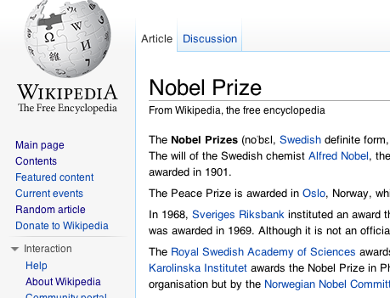
Locality-Sensitive Hashing
N_{e}
English
articles
Preprocess
Similar article pairs
N_{e}
English document vectors
<nobel=0.324, prize=0.227, book=0.01, …>
[0111000010...]
Signature generation
N_{e}
Signatures
Sliding
window
algorithm
Notes:
First, all documents are preprocessed into document
vectors (Section 4.1). Second, document signatures
are generated from document vectors (Section 4.2). Finally,
a sliding window algorithm applied to the signatures nds all
cross-lingual pairs above a similarity threshold (Section 4.3).

Slide 12
Locality-Sensitive Hashing
LSH(vector) = signature
  faster similarity computation
  s.t. similarity(vector pair) ≈ similarity(signature pair)
  e.g.,
    ~20 times faster than computing (cosine) similarity from vectors
    similarity error ≈ 0.03
Sliding window algorithm
  approximate similarity search based on LSH
  linear run-time
(Ravichandran et al., 2005)
Notes:
LSH theory

Slide 13
Sliding window algorithm
Generating tables
permute
list₁
sort
table₁
p₁
….
11111101010,1
10011000110,2
01100100100,3
…
….
01100100100,1
10011000110,2
11111101010,3
…
Signatures
.
.
.
.
.
.
….
1,11011011101
2,01110000101
3,10101010000
…
list_{Q}
sort
table_{Q}
p_{Q}
….
11111001011,1
00101001110,2
10010000101,3
…
….
00101001110,1
10010000101,2
11111001011,3
…
Map
Reduce
Notes:
p1 = Saga dogru 1 adim kaydir. 2-3’u 9-10la degistir
pQ = Son iki, ilk iki yer degistir. Ilk 5, son 5 yer degistir
We want to increase the chances that two similar signatures appear close to each other in at least one of these tables.

Slide 14
Sliding window algorithm
Detecting similar pairs
00000110101
00010001111
00100101101
00110000000
00110010000
00110011111
00110101000
00111010010
10010011011
10010110011
table₁
….
01100100100,1
10011000110,2
11111101010,3
…
.
.
.
table_{Q}
Map
Notes:
p1 = Saga dogru 1 adim kaydir. 2-3’u 9-10la degistir
pQ = Son iki, ilk iki yer degistir. Ilk 5, son 5 yer degistir

Slide 15
Sliding window algorithm
Example
# tables = 2
window size = 2
p₁
list₁
table₁
✗
# bits = 11
Distance(3,2) = 7
Distance(2,1) = 5
(<1,11111101010>,1)
(<1,10011000110>,2)
(<1,01100100100>,3)
(<1,01100100100>,3)
(<1,10011000110>,2)
(<1,11111101010>,1)
✓
Signatures
(1,11011011101)
(2,01110000101)
(3,10101010000)
p₂
list₂
table₂
✗
Distance(2,3) = 7
Distance(3,1) = 6
(<2,11111001011>,1)
(<2,00101001110>,2)
(<2,10010000101>,3)
(<2,00101001110>,2)
(<2,10010000101>,3)
(<2,11111001011>,1)
✓
Map
Reduce
Notes:
p1 = Saga dogru 1 adim kaydir. 2-3’u 9-10la degistir
pQ = Son iki, ilk iki yer degistir. Ilk 5, son 5 yer degistir

Slide 16
MT
Cross-lingual Pairwise Similarity
German
English
MT
translate
Doc A
doc vector v_{A}
English
Doc
B
doc vector v_{B}
CLIR
German
CLIR translate
Doc A
doc vector v_{A}
doc vector v_{A}
English
Doc
B
doc vector v_{B}
16
Notes:
In our view, parallel and comparable corpora lie on a
continuum of similarity, and solutions to the cross-lingual
pairwise similarity problem can unlock new sources of training
data for MT systems.
The specic application we focus on in this paper is automatically
generating links between Wikipedia articles in
dierent languages (so-called \interwiki" language links). In
addition to contributing to the overall goal of data mining for
machine translation, we believe the task is independently interesting.
For example, there presently exists a link between
the article\Friedensnobelpreis"in German and\Nobel Peace
Prize" in English. However, as far as we know, these links
are manually created, and therefore suers from many shortcomings:
Link creation requires volunteers that know both
languages and hence is a labor-intensive and error-prone endeavor.
As a result, link coverage is relatively sparse. This
is where cross-lingual pairwise similarity may help: algorithmic
output can feed into a manual verication process that
improves both speed and accuracy (e.g., with perhaps the
aid of crowdsourcing).

Slide 17
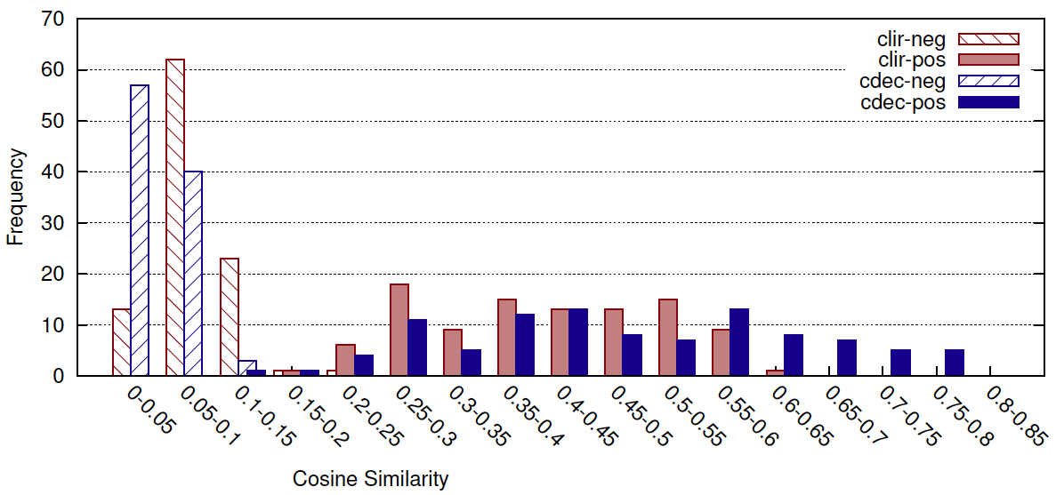
MT vs. CLIR for Pairwise Similarity
positive-negative
clearly separated
clir-neg
clir-pos
mt-neg
mt-pos
low similarity values
MT slightly better than CLIR, but 600 times slower!

Slide 18
Locality-Sensitive Hashing
for Pairwise Similarity
N_{e}
English
articles
Preprocess
Similar article pairs
N_{e}
English document vectors
<nobel=0.324, prize=0.227, book=0.01, …>
[0111000010...]
Signature generation
N_{e}
Signatures
Sliding
window
algorithm
Notes:
First, all documents are preprocessed into document
vectors (Section 4.1). Second, document signatures
are generated from document vectors (Section 4.2). Finally,
a sliding window algorithm applied to the signatures nds all
cross-lingual pairs above a similarity threshold (Section 4.3).

Slide 19
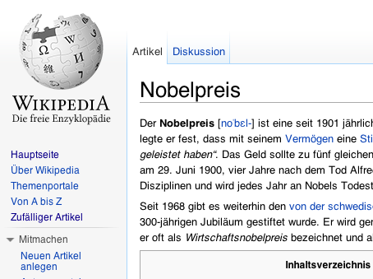
Locality-Sensitive Hashing
for Cross-Lingual Pairwise Similarity
N_{f} German articles
N_{e}
English
articles
CLIR
Translate
Preprocess
Similar article pairs
N_{e}
English document vectors
N_{e}+N_{f}
English document vectors
<nobel=0.324, prize=0.227, book=0.01, …>
[0111000010...]
Signature generation
N_{e}
Signatures
Sliding
window
algorithm
Notes:
First, all documents are preprocessed into document
vectors (Section 4.1). Second, document signatures
are generated from document vectors (Section 4.2). Finally,
a sliding window algorithm applied to the signatures nds all
cross-lingual pairs above a similarity threshold (Section 4.3).
----- Meeting Notes (4/19/12 18:32) -----
add german article pic

Slide 20
Evaluation
Experiments with De/Es/Cs/Ar/Zh/Tr to En Wikipedia
Collection: 3.44m En + 1.47m De Wikipedia articles
Task: For each German Wikipedia article, find:
{all English articles s.t. cosine similarity > 0.30}
# bits (D) = 1000
# tables (Q) = 100-1500
window size (B) = 100-2000
Notes:
EXPLAIN WHY YOU USE GERMAN
MENTION THAT YOU USE RANDOM PROJECTIONS FOR SIGNATURES
(precision can be increased by post-filtering at negligible time)
(upper-bound for recall and cost)
If precision is desired, one could always lter the extracted pairs and discard results that fall below the similarity threshold|the time necessary for this is negligible compared to the time for extracting the pairs to begin with. For instance, with parameters Q = 300;B = 2000, the number of extracted pairs is 64 million, 0.0013% of all possible cross-lingual pairs in the collection. This gives an idea of how much of the search space is ltered by the algorithm. Moreover, from an application point of view, it may not even be necessary to lter, since our threshold of 0.3 is somewhat arbitrary, and pairs with lower similarity scores may nevertheless be useful

Slide 21
Scalability
Notes:
Linear scale wrt B and Q. we also know algo scales linearly wrt collection size
In parantheses: recall

Slide 22
Evaluation
Signature generation
Sliding
window
algorithm
Similar article pairs
document vectors
Signatures
algorithm output
two sources of error
ground truth
Brute-force approach
Similar article pairs
document vectors
upperbound
Signatures
Brute-force approach
Similar article pairs
Notes:
To better understand, we need to quantify an upperbound on recall. Two sources of error: error from signatures, error from sliding window algo. We can isolate error#2 by changing the ground truth: repeat same bf procedure but use signatures instead. The result gives us upperbound of 0.76
Another analysis we did is how do results change when we use longer signatures.
----- Meeting Notes (4/19/12 18:32) -----
ground truth, explain

Slide 23
Evaluation
100% recall
no savings = no free lunch!
95% recall
39% cost
99% recall
70% cost
99% recall
62% cost
95% recall
40% cost
Notes:
A view of the effectiveness vs cost tradeoff, varied by parameter change.
Each plot is a certain value of Q, as we go to the right, the window size is increased, therefore cost increases but also effectiveness increases.
For a given goal of effectiveness, it may be wiser to choose a certain value for Q or B
e.g., if we want 95% effectiveness with minimal cost, it is best to pick 500 tables,1800 window size that’ll reach there with less than 40% cost. If you want 99% effectiveness, either Q=1000,B=2000 or Q=1500,B=1350 is a good choice. you’ll get it at relative cost of 62-63%
***** Show with only one line, then animate in rest
----- Meeting Notes (4/19/12 18:32) -----
paper citation here, add to all relevant slides

Slide 24
Outline
Introduction
Searching to Translate (IR ➔ MT)
  Cross-Lingual Pairwise Document Similarity
  Extracting Parallel Text From Comparable Corpora
Translating to Search (MT ➔ IR)
  Context-Sensitive Query Translation
Conclusions
(Ture et al., SIGIR’11)
(Ture and Lin, NAACL’12)
(Ture et al., SIGIR’12), (Ture et al., COLING’12)
(Ture and Lin, SIGIR’13)
Notes:
Quadratic complexity: need to read objects several times due to memory issues (if 1/10th of data fits in memory, need to read each object 10 times)
Mention FOCUS ON RECALL
*LARGE COLLECTIONS*
We focus on recall, that is to retrieve as many good pairs as possible., bad pairs can be easily filtered out… you can think of our task as information triage.
Our other focus is on scalability. We want to make the most out of the efficiency-effectiveness tradeoff, and we would like to scale to large amounts of data, on the web scale.

Slide 25
Phase 2: Extracting Parallel Text
Approach
  Generate candidate sentence pairs from each document pair
  Classify each candidate as ‘parallel’ or ‘not parallel’
Challenge: 10s millions doc pairs ≈ 100s billions sentence pairs
Solution: 2-step classification approach
  a simple classifier efficiently filters out irrelevant pairs
  a complex classifier effectively classifies remaining pairs
Notes:
Our approach differs from previous ones :
---no assumption on document structure (generalizable)
---an implementation that scales up to very large collections on a modest cluster (accessible to academia)
---significant results with much less data
---efficiency in classification is addressed

Slide 26
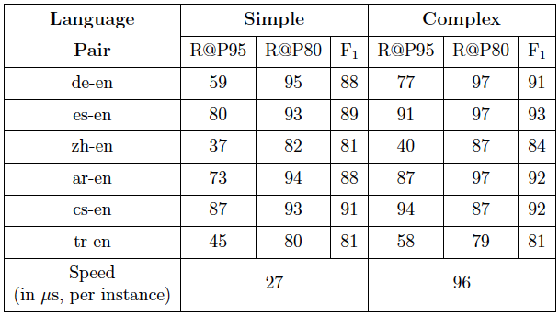
Parallel Text (Bitext) Classifier
cosine similarity of the two sentences
sentence length ratio: the ratio of lengths of the two sentences
word translation ratio: ratio of words in source (target) sentence with a translation in target (source) sentence
Notes:
Maxent = logistic regression, does not assume independence between features

Slide 27
Bitext Extraction Algorithm
cross-lingual
document pairs
candidate
generation
2.4 hours
sentences and
sent. vectors
sentence detection+tf-idf
source document
target document
400 billion
214
billion
shuffle&sort
1.3 hours
MAP
cartesian
product
REDUCE
X
complex classification
0.5 hours
sentence pairs
132
billion
simple classification
4.1 hours
bitext
S₂
complex
classification
bitext S₁
simple classification
Notes:
Notice that for each doc pair, we emit the sentences in an article through the network, which produces a lot of redundant traffic.
Alternative implementation that minimizes this redundancy = group all similar target articles to a given source article and emit all together.
This turns out much much slower due to load imbalance (4% of src articles have more than 100 links, while half have none) --- an interesting observation

Slide 28
Extracting Bitext from Wikipedia
Size | Language
 | English | German | Spanish | Chinese | Arabic | Czech | Turkish
Documents | 4.0m | 1.42m | 0.99m | 0.59m | 0.25m | 0.26m | 0.23m
Similar doc pairs | - | 35.9m | 51.5m | 14.8m | 5.4m | 9.1m | 17.1m
Sentences | ~90m | 42.3m | 19.9m | 5.5m | 2.6m | 5.1m | 3.5m
Candidate sentence pairs | - | 530b | 356b | 62b | 48b | 101b | 142b
S₁ | - | 292m | 178m | 63m | 7m | 203m | 69m
S₂ | - | 0.2-3.3m | 0.9-3.3m | 50k-290k | 130-320k | 0.5-1.6m | 8-250k
Baseline training data | - | 2.1m | 2.1m | 303k | 3.4m | 0.78m | 53k
Dev/Test set | - | WMT-11/12 | WMT-11/12 | NIST-06/08 | NIST-06/08 | WMT-11/12 | held-out
Baseline BLEU | - | 24.50 | 33.44 | 25.38 | 63.15 | 23.11 | 27.22
Notes:
About half of candidate processed (i.e., half removed by filtering heuristics)

Slide 29
Evaluation on MT
Notes:
Baseline competitive in WMT10 evaluation
Random = to isolate the effect of data, we sample from point P (i.e., condition S2).

Slide 30
Evaluation on MT
Notes:
Baseline competitive in WMT10 evaluation
Random = to isolate the effect of data, we sample from point P (i.e., condition S2).

Slide 31
Conclusions (Part I)
Summary
  Scalable approach to extract parallel text from a comparable corpus
  Improvements over state-of-the-art MT baseline
  General algorithm applicable to any data format
Future work
  Domain adaptation
  Experimenting with larger web collections

Slide 32
Outline
Introduction
Searching to Translate (IR ➔ MT)
  Cross-Lingual Pairwise Document Similarity
  Extracting Parallel Text From Comparable Corpora
Translating to Search (MT ➔ IR)
  Context-Sensitive Query Translation
Conclusions
(Ture et al., SIGIR’11)
(Ture and Lin, NAACL’12)
(Ture et al., SIGIR’12), (Ture et al., COLING’12)
(Ture and Lin, SIGIR’13)
Notes:
Quadratic complexity: need to read objects several times due to memory issues (if 1/10th of data fits in memory, need to read each object 10 times)
Mention FOCUS ON RECALL
*LARGE COLLECTIONS*
We focus on recall, that is to retrieve as many good pairs as possible., bad pairs can be easily filtered out… you can think of our task as information triage.
Our other focus is on scalability. We want to make the most out of the efficiency-effectiveness tradeoff, and we would like to scale to large amounts of data, on the web scale.

Slide 33
Cross-Language Information Retrieval
query
(ranked) documents
Information Retrieval (IR): Given information need, find relevant material.
Cross-language IR (CLIR): query and documents in different languages
  “Why does China want to import technology to build Maglev Railway?”
  relevant information in Chinese documents
  “Maternal Leave in Europe”
  relevant information in French, Spanish, German, etc.

Slide 34
Machine Translation for CLIR
sentence-aligned parallel corpus
STATISTICAL
MT
SYSTEM
token
aligner
token translation
probabilities
token
alignments
grammar
extractor
1-best translation
query
“maternal leave in Europe”
translation
grammar
“congé de maternité en Europe”
decoder
language model
language model
n best
translations
Notes:
Word → token

Slide 35
Token-based CLIR
Token translation formula
… most leave their children in …
... aim of extending maternity leave to …
.
.
.
… la plupart laisse leurs enfants…
… l’objectif de l’extension des congé de maternité à …
.
.
.
Token-based
probabilities
Notes:
Colors consistent throughout talk, pick 3 colors for 3 token alignments, draw lines between aligned tokens

Slide 36
Token-based CLIR
Maternal
leave
in
Europe
laisser (Eng. forget) → 49%
congé (Eng. time off) → 17%
quitter (Eng. quit) → 9%
partir (Eng. disappear) → 7%
…
Notes:
First go over how we get the context-indep translation
then explain the advantage of this over MT of entire query => preserve ambiguity of language in model
However, context is also helpful to get rid of ambiguity when we can… => find context-sensitive probabilistic representations
How? Use MT? -> next slide.

Slide 37
Document Retrieval
How to score a document, given a query?
Query q₁
“maternal leave in Europe”
Document
Document
Document
Document
d₁
[maternité : 0.74, maternel : 0.26]
tf(maternel)
tf(maternité)
df(maternité)
df(maternel)
…
Notes:
Define tf, df and say they are about aboutness and specificity
Say that this is better than alternative, weighted average of BM25 values

Slide 38
Token-based CLIR
Maternal
leave
in
Europe
laisser (Eng. forget) → 49%
congé (Eng. time off) → 17%
quitter (Eng. quit) → 9%
partir (Eng. disappear) → 7%
…
Notes:
First go over how we get the context-indep translation
then explain the advantage of this over MT of entire query => preserve ambiguity of language in model
However, context is also helpful to get rid of ambiguity when we can… => find context-sensitive probabilistic representations
How? Use MT? -> next slide.

Slide 39
Token-based CLIR
Maternal
leave
in
Europe
laisser (Eng. forget) → 49%
congé (Eng. time off) → 17%
quitter (Eng. quit) → 9%
partir (Eng. disappear) → 7%
…
laisser (Eng. forget) → 49%
congé (Eng. time off) → 17%
quitter (Eng. quit) → 9%
partir (Eng. disappear) → 7%
…
Notes:
Tokenbased works well in practice, and its strength is preserving ambiguities
its weakness is the inability to capture dependencies from query context

Slide 40
Context-Sensitive CLIR
Maternal
leave
in
Europe
laisser (Eng. forget) → 49%
congé (Eng. time off) → 17%
quitter (Eng. quit) → 9%
partir (Eng. disappear) → 7%
…
12%
70%
6%
5%
laisser (Eng. forget) → 49%
congé (Eng. time off) → 17%
quitter (Eng. quit) → 9%
partir (Eng. disappear) → 7%
…
This talk: MT for context-sensitive CLIR
Notes:
Tokenbased works well in practice, and its strength is preserving ambiguities
its weakness is the inability to capture dependencies from query context

Slide 41
Previous approach: Token-based CLIR
Previous approach: MT as black box
Our approach: Looking inside the box
sentence-aligned parallel corpus
MT
STATISTICAL
MT
SYSTEM
token
aligner
token translation
probabilities
token
alignments
grammar
extractor
1-best translation
query
“maternal leave in Europe”
translation
grammar
“congé de maternité en Europe”
decoder
language model
language model
n best
derivations
n best
derivations

Slide 42
MT for Context-Sensitive CLIR
sentence-aligned parallel corpus
MT
token
aligner
token translation
probabilities
token
alignments
grammar
extractor
1-best translation
query
“maternal leave in Europe”
translation
grammar
“congé de maternité en Europe”
decoder
language model
n best
translations
Notes:
Word → token

Slide 43
CLIR from translation grammar
S₁
S₁
X₁
X₁
Synchronous
hierarchical derivation
X₂
leave in Europe
congé de
X₂
en Europe
maternal
maternité
S → [X : X] , 1.0
X → [X₁ leave in europe : congé de X₁ en europe] , 0.9
X → [maternal : maternité] , 0.9
X → [X₁ leave : congé de X₁] , 0.74
X → [leave : congé ] , 0.17
X → [leave : laisser] , 0.49
...
Token translation formula
Synchronous
Context-Free
Grammar (SCFG)
[Chiang, 2007]
Grammar-based
probabilities
Notes:
Take some time on explaining grammar part
Word → token
Emphasize that these are not phrase trans probabilities that we learn, but based on phrase trans prob.s

Slide 44
MT for Context-Sensitive CLIR
sentence-aligned parallel corpus
MT
token
aligner
token translation
probabilities
token
alignments
grammar
extractor
1-best translation
query
“maternal leave in Europe”
translation
grammar
“congé de maternité en Europe”
decoder
language model
n best
translations
Notes:
Word → token

Slide 45
MT for Context-Sensitive CLIR
sentence-aligned parallel corpus
MT
token
aligner
token translation
probabilities
token
alignments
grammar
extractor
1-best translation
query
“maternal leave in Europe”
translation
grammar
“congé de maternité en Europe”
decoder
language model
n best
translations
Notes:
Talk about language model: useful but not tuned for queries
Word → token

Slide 46
CLIR from n-best derivations
S₁
S₁
S₁
S₁
X₁
t⁽²⁾: { , 0.11 }
t⁽¹⁾: { , 0.8 }
X₁
in Europe
X₁
X₁
en Europe
X₂
leave in Europe
congé de
en Europe
congé de
maternité
maternal leave
X₂
maternal
maternité
.
.
.
t^{(k)}: { k^{th} best derivation , score(t^{(k)}|s) }
Token translation formula
Translation-based
probabilities
Notes:
Translation vs derivation, explain briefly

Slide 47
MT for Context-Sensitive CLIR
1-best translation
n best
derivations
translation
grammar
token
alignments
sentence-aligned
bitext
MT pipeline
Pr_{nbest}
1-best
MT
translation
based
Context sensitivity
Pr_{SCFG}
grammar
based
Pr_{token}
token
based
Ambiguity preserved
Notes:
Add Prx values

Slide 48
Combining Evidence
For best results, we compute an interpolated probability distribution:
Pr_{token}
Pr_{SCFG}
Pr_{nbest}
leave
laisser 0.72
congé 0.10
quitter 0.09
…
leave
laisser 0.14
congé 0.70
quitter 0.06
…
leave
laisser 0.09
congé 0.90
quitter 0.11
…
40%
35%
25%
Pr_{interp}
leave
laisser 0.33
congé 0.54
quitter 0.8
…
Notes:
Show visually first, then put formula

Slide 49
Combining Evidence
For best results, we compute an interpolated probability distribution:
Pr_{token}
Pr_{SCFG}
Pr_{nbest}
leave
laisser 0.72
congé 0.10
quitter 0.09
…
leave
laisser 0.14
congé 0.70
quitter 0.06
…
leave
laisser 0.09
congé 0.90
quitter 0.11
…
0%
100%
0%
Pr_{interp}
leave
laisser 0.72
congé 0.10
quitter 0.09
…
Notes:
Show visually first, then put formula

Slide 50
Combining Evidence
For best results, we compute an interpolated probability distribution:
Notes:
Show visually first, then put formula

Slide 51
Experiments
Three tasks:
TREC 2002 English-Arabic CLIR task
50 English queries and 383,872 Arabic documents
NTCIR-8 English-Chinese ACLIA task
73 English queries and 388,859 Chinese documents
CLEF 2006 English-French CLIR task
50 English queries and 177,452 French documents
Implementation
cdec MT system [Dyer et al, 2010]
using Hiero-style grammars, GIZA++ for token alignments
Notes:
Do Not say most recent
Mention that fairly large collections and query sets

Slide 52
Comparison of Models
English-Arabic TREC 2002
Comparison of Models
English-French CLEF 2006
Comparison of Models
English-Chinese NTCIR-8
Grammar-based
Best interpolation
Translation-based (10-best)
1-best MT
Token-based
Notes:
Emphasize points in arabic and french as well
After going thru each, add slide with all together

Slide 53
Comparison of Models
Overview
Notes:
Emphasize points in arabic and french as well
After going thru each, add slide with all together

Slide 54
Comparison of Models
Interpolated significantly better than
token-based and 1-best in all three cases.
Notes:
Statistical significance test: know paper and details
randomized test:
null hypothesis = two experimental reuslts came from same model.
the probability that the same model would’ve generated MAP difference of x or more in 100,000 runs is p-value. To get the p-value we randomly generate 100000 permutations of the AP orderings, and compute MAP each time. The number of times |MAP|> x / 100000 = 2-sided p-value
MAP vs other eval metrics

Slide 55
Conclusions (Part II)
Summary
  A novel framework for context-sensitive and ambiguity-preserving CLIR
  Interpolation of proposed models works best
  Significant improvements in MAP for three tasks
Future work
  Robust parameter optimization
  Document vs. query translation with MT
Notes:
Future: explore multi-word expressions

Slide 56
Contributions
comparable
corpora
Bitext
Extraction
baseline
bitext
extracted
bitext
+
MT
pipeline
Token-based
CLIR
MT
Translation
Model
CLIR
Translation Model

Slide 57
Contributions
comparable
corpora
Bitext
Extraction
baseline
bitext
extracted
bitext
+
MT
pipeline
Token-based
CLIR
Higher BLEU
for
5 lang pairs
MT
Translation
Model
CLIR
Translation Model

Slide 58
Contributions
baseline
bitext
MT
pipeline
Context-sensitive CLIR
Token-based
CLIR
MT
Translation
Model
CLIR
Translation Model

Slide 59
Contributions
baseline
bitext
MT
pipeline
Context-sensitive CLIR
MT
Translation
Model
CLIR
Translation Model
Higher MAP
for
3 lang pairs

Slide 60
Contributions
comparable
corpora
Bitext
Extraction
baseline
bitext
extracted
bitext
+
MT
pipeline
Context-sensitive CLIR
Higher BLEU
for
5 lang pairs
MT
Translation
Model
CLIR
Translation Model
Higher MAP
for
3 lang pairs

Slide 61
Contributions
comparable
corpora
Higher BLEU
after additional
iteration
Bitext
Extraction
more
bitext
baseline
bitext
extracted
bitext
+
MT
pipeline
Token-based
CLIR
MT
Translation
Model
CLIR
Translation Model
CLIR
Translation Model
Notes:
Say bootstrapping approach

Slide 62
Contributions
LSH-based MapReduce approach to pairwise similarity
Exploration of parameter space for sliding window algorithm
MapReduce algorithm to generate candidate sentence pairs
2-step classification approach to bitext extraction
→ Bitext from Wikipedia: improvement over state-of-the-art MT
Set of techniques for context-sensitive CLIR using MT
→ Combination-of-evidence works best
Framework for better integration of MT and IR
Bootstrapping approach to show feasibility
All code and data as part of Ivory project (www.ivory.cc)
Notes:
(e.g., mining web for more data, tuning on millions of sentences w/ sparse features)

Slide 63
Thank you!

Slide 64
Cross-lingual Pairwise Similarity
In a comparable corpus, find similar document pairs that are in different languages
Challenge: loss of information during translation
Goals
  A first step for parallel sentence extraction
  Contribute to multi-lingual collections such as Wikipedia
Notes:
An essential first step for parallel sentence extraction
training data for multi-lingual learning algorithms such as Machine Translation
Contribute to multi-lingual collections such as Wikipedia
automate generation of “interwiki” language links
Machine Translation (MT) is one solution to this need, but depends on large amounts of manually created parallel text for good results
In our view, parallel and comparable corpora lie on a
continuum of similarity, and solutions to the cross-lingual
pairwise similarity problem can unlock new sources of training
data for MT systems.
The specic application we focus on in this paper is automatically
generating links between Wikipedia articles in
dierent languages (so-called \interwiki" language links). In
addition to contributing to the overall goal of data mining for
machine translation, we believe the task is independently interesting.
For example, there presently exists a link between
the article\Friedensnobelpreis"in German and\Nobel Peace
Prize" in English. However, as far as we know, these links
are manually created, and therefore suers from many shortcomings:
Link creation requires volunteers that know both
languages and hence is a labor-intensive and error-prone endeavor.
As a result, link coverage is relatively sparse. This
is where cross-lingual pairwise similarity may help: algorithmic
output can feed into a manual verication process that
improves both speed and accuracy (e.g., with perhaps the
aid of crowdsourcing).

Slide 65
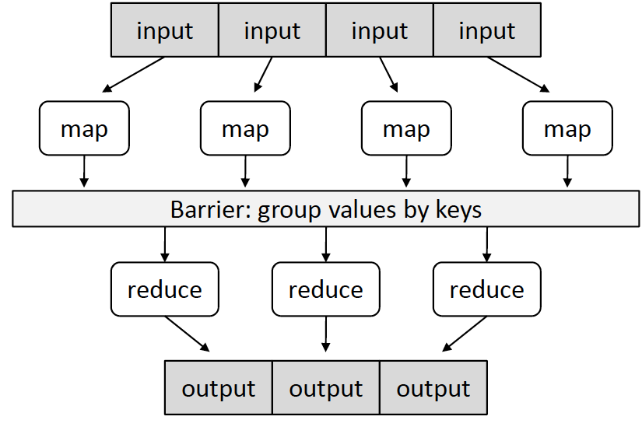
MapReduce
• Map: (k, v) ↦ <(k₁,v₁), (k₂,v₂), (k₃,v₃),…,(k_{n},v_{n})>
• Reduce: (k', <v’₁, v’₂,…,v’_{m}>) ↦ <(k’’, v'’₁), (k’’, v'’₂),…,(k’’, v’’_{n})>
Notes:
p1 = Saga dogru 1 adim kaydir. 2-3’u 9-10la degistir
pQ = Son iki, ilk iki yer degistir. Ilk 5, son 5 yer degistir
We want to increase the chances that two similar signatures appear close to each other in at least one of these tables.

Slide 66
Selecting Sentence Pairs
complex > 0.60
2-step
WMT10 train
complex > 0.65
simple > 0.98
random sampling
simple> 0.986
1-step
WMT10 train
simple > 0.992
data size
(in millions)
0
3.1
8.1
16.9
5.3
Conclusions
with same amount, S₂ outperforms S₁
more data sampled => higher BLEU, until certain point
Notes:
Tuned on tuning and testing sets provided for wmt10 = 2525 tune, 2489 test. MIRA for tuning.
Ranked 5th out of 9 participants in wmt10 that reported comparable results
----- Meeting Notes (4/19/12 18:32) -----
add 1-step, 2-step on the two rows

Slide 67
Bitext Extraction Approaches
2-step>1-step consistently
data BLEU
noisy data with S₁
Notes:
Baseline competitive in WMT10 evaluation
Random = to isolate the effect of data, we sample from point P (i.e., condition S2).

Slide 68
Evaluation on MT
Notes:
Baseline competitive in WMT10 evaluation
Random = to isolate the effect of data, we sample from point P (i.e., condition S2).

Slide 69
Ture et al, SIGIR’11
Analytical Model
We derived an analytical model of our algorithm
  based on a deterministic approximation
  formula to estimate recall, given parameters
  tradeoff analysis without running any experiments
Notes:
What if we want to do these analyses without picking a sample and running all these experiments. Is there a way to analytically estimate effectiveness?
Here’s a rough model we derived, that’ll do exactly that
TODO = Read proof of eq.3

Slide 70
Ture et al, SIGIR’11
Analytical Model
Notes:
----- Meeting Notes (4/19/12 18:32) -----
change plot that goes up to high recall

Slide 71
Ture et al, SIGIR’11
Contributing to Wikipedia
Identify links between German and English Wikipedia articles
  “Metadaten” → “Metadata”, “Semantic Web”, “File Format”
  “Pierre Curie” → “Marie Curie”, “Pierre Curie”, “Helene Langevin-Joliot”
  “Kirgisistan” → “Kyrgyzstan”, “Tulip Revolution”, “2010 Kyrgyzstani uprising”, “2010 South Kyrgyzstan riots”, “Uzbekistan”
Worse performance when:
  significant difference in length (e.g. specific to Germany)
  highly technical articles (e.g. chemical elements)

Slide 72
Cross-Language IR: Overview
French
collection
CLIR
Translation
English
collection
Indexing
index of English
collection
English
query
Retrieval Engine
Evaluation
Ranked list of documents
Relevance judgments
Notes:
Show non-English colleciton → french chinese etc.

Slide 73
Cross-Language IR: Overview
English
query
French
collection
this talk
CLIR
Translation
Indexing
index of French
collection
French query
Retrieval Engine
Evaluation
Relevance
judgements
Ranked list of documents
Notes:
Show English query translated into french chinese etc.

Slide 74
Locality-Sensitive Hashing
for Pairwise Similarity
Simhash
  Each bit determined by average of term hash values
MinHash
  Order terms by hash, pick K terms with minimum hash
Random projections (RP)
  Each bit determined by inner product between random unit vector and doc vector
Notes:
Comparison wrt efficiency and effectiveness
# of bits?
Simhash: Hash each term, then compute weighted average of hash values to determine each bit of the signature.
Minhash: Compute hash for each term in vocabulary. Signature of a vector is the K terms with minimum hash values.
Random projections: Each bit of the signature is determined by an inner product between a random hyper-plane and the document vector.

Slide 75
Future Work
Extracting parallel text from the web
Domain adaptation in MT
  use CLIR/IR and Phase 1 to find in-domain parallel text
Language context in NLP
  Context-sensitive vs. Token-based CLIR
  Document vs. sentence-level MT
Representing phrases in CLIR
  Ad-hoc approach does not improve
Document vs. query translation in CLIR
(Ture et. al, NAACL’12)
Notes:
(e.g., mining web for more data, tuning on millions of sentences w/ sparse features)

Slide 76
Comparison of Variants
MT approach: Flat vs Hierarchical
  → hierarchical > flat for grammar-based CLIR
  → hierarchical ~ flat for translation-based CLIR
  → interpolated > token with either (except flat-Arabic)
  → interpolated > 1-best with either (except flat-French)
Heuristic for source tokens aligned to many target tokens
  → no clear winner (mostly one-to-many)
➔ Focus on hierarchical MT & one-to-many
Notes:
Heuristic for source tokens aligned to many target tokens
One-to-none
One-to-one
One-to-many

Slide 77
Comparison of Models
Interpolated significantly better than
token-based in all three cases,
better than 1-best and 10-best for Ar and Zh
Notes:
Statistical significance test: know paper and details
randomized test:
null hypothesis = two experimental reuslts came from same model.
the probability that the same model would’ve generated MAP difference of x or more in 100,000 runs is p-value. To get the p-value we randomly generate 100000 permutations of the AP orderings, and compute MAP each time. The number of times |MAP|> x / 100000 = 2-sided p-value
MAP vs other eval metrics

Slide 78
Efficiency vs. Effectiveness

Slide 79
Experiments: Finding good λ₁ and λ₂
Learn from different queries in same collection?
✔
Learn from different collection in different language?
✗
Learn from different collection in same language?
?
Change in training resources?
?

Slide 80
CLIR from translation grammar
[maternal : maternité],0.9
[leave : congé],0.69
Flat derivation
maternal
leave in Europe
congé de
maternité
en Europe
[in europe : en europe],0.74
[maternal : maternité] , 0.9
[in europe : en europe] , 0.74
[maternity leave : congé de maternité] , 0.74
[leave : congé ] , 0.17
[leave : laisser] , 0.49
...
[paternity leave : congé de paternité] , 0.70
Token translation formula
Phrase table
or “flat grammar”
[Koehn et al., 2003]
Grammar-based
probabilities (flat)
Notes:
Take some time on explaining grammar part
Word → token
Emphasize that these are not phrase trans probabilities that we learn, but based on phrase trans prob.s

Slide 81
10-best>Token,Grammar,1-best
NBA labor conflict
NBA
travail +social (Token,Grammar)
confl, conflit +contradict (Token,Grammar)
Grammar>10-best
Centenary celebrations
centenaire
+celebration (G)
Token>Grammar>10-best
Theft of “The Scream”
vol de \Scream”
vs.
vol du “Cri"

Slide 82
Also…
  Analytical model to estimate algorithm recall
  Error analysis of bitext output
  Comparison of bitext extraction approaches
Also…
  Flat (cdec) vs Hierarchical MT (Moses) for CLIR
  Efficiency analysis of CLIR models

