Slide 1
No Free Lunch: Brute Force vs Locality-Sensitive Hashing for Cross-Lingual Pairwise Similarity
Ferhan Ture¹
Tamer Elsayed²
Jimmy Lin^{1,3}
¹ Department of Computer Science, University of Maryland
² Mathematical and Computer Sciences and Engineering, King Abdullah University of Science and Technology (KAUST)
³ The iSchool, University of Maryland

Slide 2
Pairwise Similarity
Pairwise similarity:
finding similar pairs of documents in a large collection
Challenges
quadratic search space
measuring similarity effectively and efficiently
Focus on recall and scalability
Applications
clustering for unsupervised learning
generation of similarity lists for “more-like-this” queries
near-duplicate detection in the web context
Notes:
Quadratic complexity: need to read objects several times due to memory issues (if 1/10th of data fits in memory, need to read each object 10 times)
Mention FOCUS ON RECALL
*LARGE COLLECTIONS*
We focus on recall, that is to retrieve as many good pairs as possible., bad pairs can be easily filtered out… you can think of our task as information triage.
Our other focus is on scalability. We want to make the most out of the efficiency-effectiveness tradeoff, and we would like to scale to large amounts of data, on the web scale.

Slide 3
Pairwise Similarity
Approaches
index-based approach
builds an inverted index and prunes it for pairwise similarity
e.g., Hadjieleftheriou et al [2008], Bayardo et al [2007], Smith et al [2010],
Robertson et al [1994], Chowdhury et al [2002], Vernica et al [2010]
signature-based approach
converts document into a compact representation, then performs
similarity computations
e.g., Manku et al [2007], Lin [2009], Henzinger [2006], Huang et al [2008]
Notes:
After this slide, provide overivew of LSH, sliding window
Then introduce CL variant:
Then say, how do you do?
Translate via MT
Project vector etc.
In its most general form, pairwise similarity computation
deals with nding pairs of objects in a large dataset that
are similar according to some measure. This problem is
frequently encountered in text processing applications, for
example, clustering for unsupervised learning [27, 25], generation
of similarity lists for \more-like-this" queries [19],
and near-duplicate detection in the web context. Instances
of this problem are encountered in other domains such as
bioinformatics as well (e.g., [22]).
The general problem of efficiently computing pairwise similarity
has attracted much attention as the amount of available
data (particularly the web) continues to grow. In general,
two approaches to the problem exist: the index-based
approach focuses on building an inverted index and pruning
it to achieve efficient similarity computations; and the
signature-based approach that transforms the data into a
more compact representation and performs similarity comparisons
in the new representation. The locality-sensitive
hashing (LSH) [4, 5, 2] techniques we adopt exemplifies the
second approach.

Slide 4
Locality-Sensitive Hashing for Pairwise Similarity
Locality-Sensitive Hashing (LSH) is a method for effectively reducing the search space when looking for similar pairs
Vectors are converted into signatures, such that similar vectors are likely to have similar signatures (Charikar, 2002)
A sliding window algorithm uses these signatures to search for similar articles in the collection (Ravichandran et al, 2005)
Notes:
Documents are represented as vectors of term weights, and cosine similarity involves a lot of flops. LSH aims to reduce the running time of this procedure. The idea is to convert vectors into a fixed-size bit sequence, called a signature, such that similar vectors are likely to have similar signatures. Similarity between signatures can be computed by counting the number of bits that differ, called the Hamming Distance, and there is a formula that connects this distance to the cosine similarity between the vectors.
Cosine score is a good similarity measure but computation with flops is infeasible for large collections

Slide 5
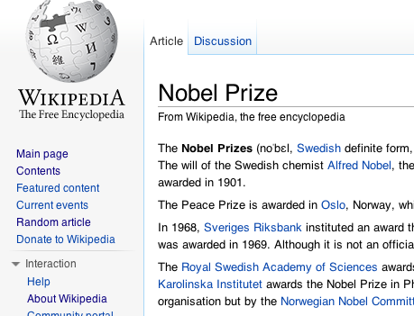
Locality-Sensitive Hashing for Pairwise Similarity
N_{e}
English
articles
Preprocess
Similar article pairs
N_{e}
English document vectors
<nobel=0.324, prize=0.227, book=0.01, …>
[0111000010...]
Signature generation
N_{e}
Signatures
Sliding
window
algorithm
Notes:
First, all documents are preprocessed into document
vectors (Section 4.1). Second, document signatures
are generated from document vectors (Section 4.2). Finally,
a sliding window algorithm applied to the signatures nds all
cross-lingual pairs above a similarity threshold (Section 4.3).

Slide 6
Locality-Sensitive Hashing for Pairwise Similarity
Simhash
Each bit determined by average of term hash values
MinHash
Order terms by hash, pick K terms with minimum hash
Random projections (RP)
Each bit determined by inner product between random unit vector and doc vector
Notes:
Comparison wrt efficiency and effectiveness
# of bits?
Simhash: Hash each term, then compute weighted average of hash values to determine each bit of the signature.
Minhash: Compute hash for each term in vocabulary. Signature of a vector is the K terms with minimum hash values.
Random projections: Each bit of the signature is determined by an inner product between a random hyper-plane and the document vector.

Slide 7
Locality-Sensitive Hashing for Pairwise Similarity
Method | # bits | Avg. absolute error | Time (ms / signature)
Minhash | 64 | 0.06 | 0.28
Simhash | 64 | 0.24 | 0.25
RP | 64 | 0.15 | 1.17
RP | 100 | 0.12 | 2.03
RP | 200 | 0.09 | 4.52
RP | 500 | 0.06 | 10.93
RP | 1000 | 0.04 | 20.91
Minhash | 992 | 0.05 | 1.82
long RP most accurate
RP ~5x slower
RP flexible with # bits
Notes:
Mention number of bits before here
In order to compare the precision of these three signature
generation techniques, we selected a sample of 1064 document
vectors from German Wikipedia. Forevery pair of document
vectors, we computed the true cosine similarity and
estimated values using each of the three signature methods
and varying signature lengths. In each case, we computed
the average absolute difference between the true and estimated
cosine similarity value, shown in Table 1. For comparison,
the last column shows the average time (in milliseconds)
taken to generate one signature on a laptop with an
Intel Core 2 Duo 2.26 GHz processor

Slide 8
Sliding window algorithm Table generation phase
tables
permute
S₁
sort
S₁’
p₁
….
11111101010
10011000110
01100100100
…
….
01100100100
10011000110
11111101010
…
Signatures
.
.
.
….
11011011101
01110000101
10101010000
…
S_{Q}
sort
S_{Q}’
p_{Q}
….
11111001011
00101001110
10010000101
…
….
00101001110
10010000101
11111001011
…
Q=# tables
Map
Reduce
Notes:
p1 = Saga dogru 1 adim kaydir. 2-3’u 9-10la degistir
pQ = Son iki, ilk iki yer degistir. Ilk 5, son 5 yer degistir
We want to increase the chances that two similar signatures appear close to each other in at least one of these tables.

Slide 9
Sliding window algorithm Detection phase
00000110101
00010001111
00100101101
00110000000
00110010000
00110011111
00110101000
00111010010
10010011011
10010110011
tables
.
.
.
B = window size
Map
Notes:
p1 = Saga dogru 1 adim kaydir. 2-3’u 9-10la degistir
pQ = Son iki, ilk iki yer degistir. Ilk 5, son 5 yer degistir

Slide 10
Cross-lingual Pairwise Similarity
In a multi-lingual text collection, find similar document pairs that are in different languages
driven by an evolution toward more multi-lingual and multi-cultural societies
more difficult due to loss of information during translation
Goals
An essential first step for parallel sentence extraction
Contribute to multi-lingual collections such as Wikipedia
Notes:
An essential first step for parallel sentence extraction
training data for multi-lingual learning algorithms such as Machine Translation
Contribute to multi-lingual collections such as Wikipedia
automate generation of “interwiki” language links
Machine Translation (MT) is one solution to this need, but depends on large amounts of manually created parallel text for good results
In our view, parallel and comparable corpora lie on a
continuum of similarity, and solutions to the cross-lingual
pairwise similarity problem can unlock new sources of training
data for MT systems.
The specic application we focus on in this paper is automatically
generating links between Wikipedia articles in
dierent languages (so-called \interwiki" language links). In
addition to contributing to the overall goal of data mining for
machine translation, we believe the task is independently interesting.
For example, there presently exists a link between
the article\Friedensnobelpreis"in German and\Nobel Peace
Prize" in English. However, as far as we know, these links
are manually created, and therefore suers from many shortcomings:
Link creation requires volunteers that know both
languages and hence is a labor-intensive and error-prone endeavor.
As a result, link coverage is relatively sparse. This
is where cross-lingual pairwise similarity may help: algorithmic
output can feed into a manual verication process that
improves both speed and accuracy (e.g., with perhaps the
aid of crowdsourcing).

Slide 11
MT
German
MT
translate
English
Doc A
doc vector v_{A}
English
Doc
B
doc vector v_{B}
German
CLIR translate
Doc A
CLIR
doc vector v_{A}
doc vector v_{A}
English
Doc
B
doc vector v_{B}
Notes:
In our view, parallel and comparable corpora lie on a
continuum of similarity, and solutions to the cross-lingual
pairwise similarity problem can unlock new sources of training
data for MT systems.
The specic application we focus on in this paper is automatically
generating links between Wikipedia articles in
dierent languages (so-called \interwiki" language links). In
addition to contributing to the overall goal of data mining for
machine translation, we believe the task is independently interesting.
For example, there presently exists a link between
the article\Friedensnobelpreis"in German and\Nobel Peace
Prize" in English. However, as far as we know, these links
are manually created, and therefore suers from many shortcomings:
Link creation requires volunteers that know both
languages and hence is a labor-intensive and error-prone endeavor.
As a result, link coverage is relatively sparse. This
is where cross-lingual pairwise similarity may help: algorithmic
output can feed into a manual verication process that
improves both speed and accuracy (e.g., with perhaps the
aid of crowdsourcing).

Slide 12
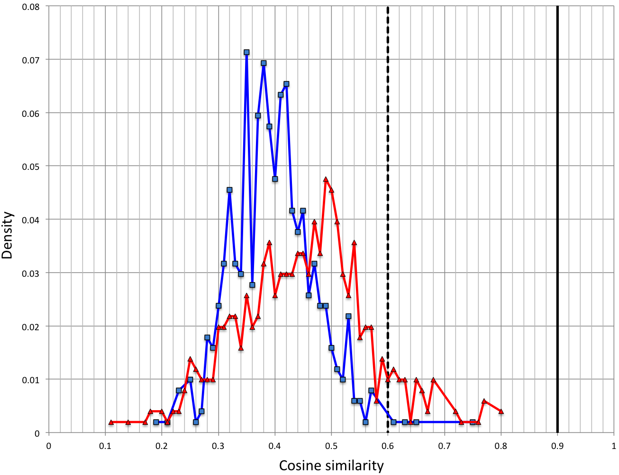
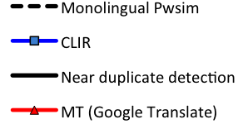
CLIR vs MT
Notes:
Draw two vertical lines: one at 0.5, which is the R&Hovy limit
Draw vertical line at 0.90: typical for deduping
** MUCH HARDER PROBLEM
→ This is not a talk about CLIR, it is instead the source of the problems that we wish to solve by implementing an LSH-based scalable approach to pwsim
In our view, parallel and comparable corpora lie on a
continuum of similarity, and solutions to the cross-lingual
pairwise similarity problem can unlock new sources of training
data for MT systems.
The specic application we focus on in this paper is automatically
generating links between Wikipedia articles in
dierent languages (so-called \interwiki" language links). In
addition to contributing to the overall goal of data mining for
machine translation, we believe the task is independently interesting.
For example, there presently exists a link between
the article\Friedensnobelpreis"in German and\Nobel Peace
Prize" in English. However, as far as we know, these links
are manually created, and therefore suers from many shortcomings:
Link creation requires volunteers that know both
languages and hence is a labor-intensive and error-prone endeavor.
As a result, link coverage is relatively sparse. This
is where cross-lingual pairwise similarity may help: algorithmic
output can feed into a manual verication process that
improves both speed and accuracy (e.g., with perhaps the
aid of crowdsourcing).

Slide 13
Locality-Sensitive Hashing for Cross-lingual Pairwise Similarity
Locality-Sensitive Hashing for Pairwise Similarity
N_{f} German articles
N_{e}
English
articles
CLIR
Translate
Preprocess
Okapi BM25 weights
1000-bit RP signatures
Similar article pairs
N_{e}
English document vectors
N_{e}+N_{f}
English document vectors
<nobel=0.324, prize=0.227, book=0.01, …>
[0111000010...]
Signature generation
N_{e}+N_{f}
Signatures
Sliding
window
algorithm
N_{e}
Signatures
Notes:
First, all documents are preprocessed into document
vectors (Section 4.1). Second, document signatures
are generated from document vectors (Section 4.2). Finally,
a sliding window algorithm applied to the signatures nds all
cross-lingual pairs above a similarity threshold (Section 4.3).

Slide 14
Evaluation
Collection: 3.44m English + 1.47m German Wikipedia
Task: sample of 1064 German articles, find all similar English articles for each sample article with cosine score > 0.3
Ground truth: Use document vectors to find all pairs with cosine score > 0.3 (brute force)
Evaluation
Effectiveness: recall
Efficiency: time, number of comparisons
Baseline: Compare sliding window against brute force approach
Notes:
EXPLAIN WHY YOU USE GERMAN
MENTION THAT YOU USE RANDOM PROJECTIONS FOR SIGNATURES
(precision can be increased by post-filtering at negligible time)
(upper-bound for recall and cost)
If precision is desired, one could always lter the extracted pairs and discard results that fall below the similarity threshold|the time necessary for this is negligible compared to the time for extracting the pairs to begin with. For instance, with parameters Q = 300;B = 2000, the number of extracted pairs is 64 million, 0.0013% of all possible cross-lingual pairs in the collection. This gives an idea of how much of the search space is ltered by the algorithm. Moreover, from an application point of view, it may not even be necessary to lter, since our threshold of 0.3 is somewhat arbitrary, and pairs with lower similarity scores may nevertheless be useful

Slide 15
Evaluation (time)
Notes:
Linear scale wrt B and Q. we also know algo scales linearly wrt collection size
In parantheses: recall

Slide 16
Evaluation
Two sources of error: (1) from signatures, (2) from sliding window algorithm.
Upper-bound cost = # comparisons in brute force approach
= 5.1 trillion comparisons
Upper-bound recall = recall if we looked at all signature pairs = 0.763
Define
Relative recall = recall / upper-bound recall
Relative cost = # comparisons / upper-bound cost
Notes:
To better understand, we need to quantify an upperbound on recall. Two sources of error: error from signatures, error from sliding window algo. We can isolate error#2 by changing the ground truth: repeat same bf procedure but use signatures instead. The result gives us upperbound of 0.76
Another analysis we did is how do results change when we use longer signatures.

Slide 17
Evaluation (# comparisons)
Notes:
Compute effectiveness only for sample article to speed up experiments
View the cost of the algo side by side with the brute force upperbound
Show Q=100,200,300 from previous slide, we’re far below the upper bound.
then animate in rest of the Q values, try to find a good spot below the vertical line with max recall.
→ theres a tradeoff between more tables and larger window size and there’s also a tradeoff between higher recall (close to horizontal line) and lower cost (farther from horizontal line)
In order to explore these tradeoffs, we plot … (NEXT SLIDE) the relative effectiveness on y-axis and relative cost on x-axis

Slide 18
Evaluation
100% recall
no savings = no free lunch!
95% recall
39% cost
99% recall
70% cost
99% recall
62% cost
95% recall
40% cost
Notes:
A view of the effectiveness vs cost tradeoff, varied by parameter change.
Each plot is a certain value of Q, as we go to the right, the window size is increased, therefore cost increases but also effectiveness increases.
For a given goal of effectiveness, it may be wiser to choose a certain value for Q or B
e.g., if we want 95% effectiveness with minimal cost, it is best to pick 500 tables that’ll reach there with less than 40% cost. If you want 99% effectiveness, either 1000 or 1500 tables is a good choice. you’ll get it at relative cost of 62-63%
***** Show with only one line, then animate in rest

Slide 19
Analytical Model
We derived an analytical model of our algorithm
based on a deterministic approximation
provides a formula to estimate recall, given parameters
allows tradeoff analysis without running any experiments
Notes:
What if we want to do these analyses without picking a sample and running all these experiments. Is there a way to analytically estimate effectiveness?
Here’s a rough model we derived, that’ll do exactly that
TODO = Read proof of eq.3

Slide 20
Analytical Model

Slide 21
Contribution to Wikipedia
Identify links between German and English Wikipedia articles
“Metadaten” → “Metadata”, “Semantic Web”, “File Format”
“Pierre Curie” → “Marie Curie”, “Pierre Curie”, “Helene Langevin-Joliot”
“Kirgisistan” → “Kyrgyzstan”, “Tulip Revolution”, “2010 Kyrgyzstani uprising”, “2010 South Kyrgyzstan riots”, “Uzbekistan”
Bad results when significant difference in length (e.g. specific to Germany) and technical articles (e.g. chemical elements)

Slide 22
Conclusions
LSH-based approach to solve Cross-lingual Pairwise Similarity
A parallel, MapReduce-based scalable implementation as part of the Ivory project at University of Maryland
(source code downloadable from: https://github.com/lintool/Ivory)
Theoretically and experimentally quantified the effectiveness vs efficiency tradeoff
Future work
improved vocabularies, named entity recognition
apply to other language pairs
next step: extract parallel sentences from similar document pairs

Slide 23
Thank you!
Code URL: https://github.com/lintool/Ivory Contact: fture@cs.umd.edu

