Slide 1
Auto-annotation for Voice-enabled Entertainment Systems
Wenyan Li, Ferhan Ture
Comcast Applied AI Research Lab
Notes:
Hi everyone, my name is Wenyan Li, I am a Research Engineer from Comcast Applied AI Research, The paper I will be presenting today is titled Auto-annotation for Voice-enabled entertainment systems.

Slide 2
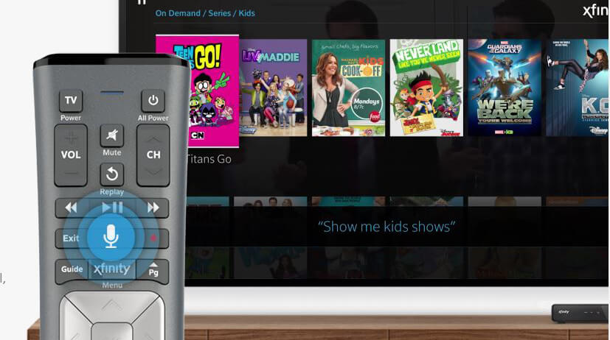
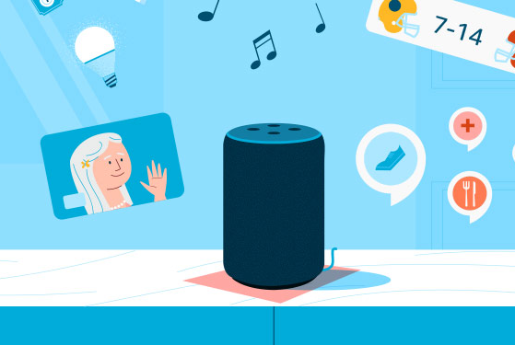
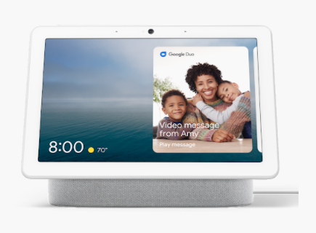
Motivation
Voice-activated intelligent entertainment systems are prevalent in our daily lives
in specialized domains
Labeled audio data
time consuming
shifting customer trends
labor intensive
Automatic Speech Recognition
Comcast X1
Amazon Alexa
Google Nest Hub
Notes:
As we can be aware of that voice -activated intelligent systems are prevalent in our daily lives, millions of customers interact with products such as Comcast X1... everyday.
These devices use ASR systems to convert speech to text and fed into downstream modules for different types of functions. While ASR has shown impressive ability with deep neural networks and supervised learning, they are far from perfect, and labeling audio data for training ASR models is often time-consuming, labor-intensive; when training data are in specialized domains and needs to adapt to domain specifics and shifting customer trends, annotate/correct on each transcription is almost impossible.

Slide 3
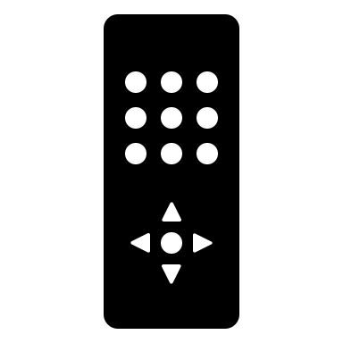
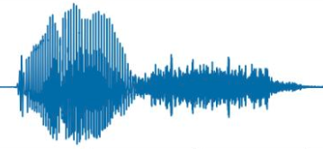
Proposal
Identify errors and provide reasonable corrections in ASR systems automatically
Obtain training data for production-level ASR systems in an unsupervised manner
Ground truth
Failure cases
Ground truth
Human
Annotation
“Treadstone”
“Treadstone”
“Treadstone”
“Treadstone”
Automatic
Inference
Training samples
Training labels
“Tradestone”
ASR System
transcription
ASR Error Detection
Annotation and Correction
Notes:
To alleviate this key problem and to improve the ASR systems, it is crucial to Identify errors and provide reasonable corrections in ASR systems automatically, and obtain training data for production-level ASR systems in an unsupervised manner

Slide 4
RoadMap
Motivation
Proposal
Prior work
Auto-annotation Methods:
Utterance-based
Interaction-based
Evaluation
Conclusion
Notes:
Millions of customers use voice-activated intelligent entertainment systems like Comcast X1 and Amazon Alexa every day.
Labeling data is even more time-consuming and labor-intensive in specialized domains where training data needs to adapt to domain specifics and shifting customer trends. This makes manual annotation and correction for
every transcription almost impossible.

Slide 5
Prior Work
Fully Supervised
Lexical and acoustic features of query reformulation [Tang, et al. 2019;
Errattahi, et al. 2018; Errattahi, et al. 2016]
- Audio-only interactions [Hong and Findlater. 2018]
Weakly supervised
acoustic audio event detection [Kumar and Raj. 2016, Kumar et al. 2017]
Production-level
human-in-the-loop [Amazon SageMaker]
Notes:
Recent research examined both lexical and acoustic features of query reformulation, or use audio-only interactions to characterize and detect speech recognition errors, they all based on fully supervised methods using manually labeled dataset.
While weak supervision advances in multi-label text and image classification, existing efforts on using weakly-labeled audios are limited.
Unsupervised annotation on ASR transcriptions remains under-explored.

Slide 6
RoadMap
Prior work
Auto-annotation Methods:
Utterance-based :
- transcriptions only
Interaction-based:
- transcriptions + interaction events (app, tune, keypress)
Evaluation
Conclusion
Notes:
Now let me introduce you to our unsupervised auto-annotation methods:
we experimented with both utterance-based and interaction-based methods, where the former uses only voice transcriptions , while the latter incorporate also user interaction events.

Slide 7
Data: utterance sessions
Each query is issued by the same device.
Each non-first query occurs within 45 seconds of the last. (Tang et al., 2018)
transcriptions are grouped by device
and sorted by time
t₀
t₁
t_{n-1}
t_{n}
If t_{n}-t_{n-1} > 45s, have a session = events[t₀ : t_{n-1}]
Sessions:
[
,
,
]
[[{‘time': 'Mon Oct 7 00:11:19 2019', 'transcription': 'NBC America'}
{‘time': 'Mon Oct 7 00:11:23 2019', 'transcription': 'NBC America'},
{‘time': 'Mon Oct 7 00:11:35 2019', 'transcription': 'NBC'}]
Notes:
Utterance-based method use only sessionized ASR transcriptions for automatic error detection and correction.
We group the events by device and sort them by timestamps;
We measure the time interval between every pair of two continuous events in the event series
If the interval > DEFINED_INTERVAL, we split the events series into sessions:

Slide 8
Utterance-based Detection and Annotation
Step 1: Identifying erroneous transcriptions
Step 2: Automatic annotation with query reformulation patterns
Session
query = Log house
□ more than one utterances
□ no repeated transcriptions
□ second last query is erroneous
□ Median of time interval < T_{t}
□ have more than one utterances
□ contain repeats
sessions
Query
Erroneous
Extract possible candidates from all sessions
Select correction by confidence
□ Number of session > T_{s}
□ Repeat likelihood > T_{rep}
□ Median of time interval between repeats < T_{t}
q_{err}
q_{i’}
('Log House', 'Loud House'), 0.44
('Log House', 'The Loud House'), 0.125
…
Notes:
have shown that WER is positively correlated to session length and users have a high probability of repetition when facing transcription errors.
We investigate sessions that contain multiple queries which are not exact repeats in transcriptions. In these sessions, users try to reformulate the query with variations in speech rate, pronunciations, etc., that yield different transcriptions from ASR. As shown in previous work that the last query in the session has a much lower word error rate on average, thus we consider the last query in a session to more likely be the corrected transcription of the previous query.

Slide 9
RoadMap
Prior work
Auto-annotation Methods:
Utterance-based :
- transcriptions only
Interaction-based:
- transcriptions + interaction events (app, tune, keypress)
Evaluation
Conclusion
Notes:
Now let me introduce you our on auto-annotation methods:
we experimented with both utterance-based and interaction-based methods, where the former uses only voice transcriptions , while the latter incorporate also user interaction events.

Slide 10
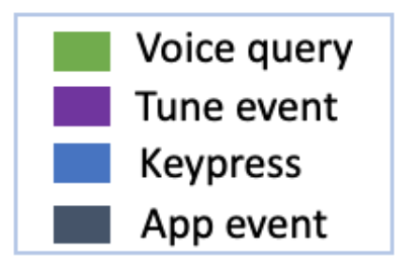
Interaction-based Detection and Annotation
Three scenarios where subsequent user interactions lead to a confirmed transcription
< 30s
t
Scenario 1: User clicks a button, tunes to a program, then keeps watching > 30 seconds.
Time-ordered session events
e₁
e₂
…
e_{t}
Step 1:
Extract
scenario 1
scenario 2
scenario 3
Scenario 2: User launches an app and stays for at least 30 seconds
Last voice query
& subsequent
interactions
Enter
30s+
30s+
150s+
query, click, tune, watch
query, app, app running
query, tune, watch
Scenario 3: User tunes to a program and stays for at least 150
seconds.
Last voice query
“The Amazing World of Gumball”
”Peacock”
“HGTV”
Step 2:
Compare
Tune/App
The Amazing World of Gumball: S3 Ep33
AppName: Peacock
Status: running
HGTV
high-quality training data for an ASR system
Notes:
We also sessionize the event in interaction-based methods,
1) The session begins with a voice query.
2) Each non-voice event occurs within 30 seconds of the last event.
3) A tuning event or app launch event occurs at the end, within 30 seconds of the previous event.
We hypothesize that users’ consecutive behavior (after they utter a command) reflects their underlying intent.
From each session, we extract the last voice query and subsequent events to approximate user’s final intent. and if the user subsequent action matches with their previous voice query, we can confirm the query transcription to be correct.
Scenario 1: User clicks a button, tunes to a program, then keeps watching for at least 30 seconds.
Scenario 2: User launches an app and stays for at least 30 seconds.
Scenario 3: User tunes to a program and stays for at least 150 seconds.

Slide 11
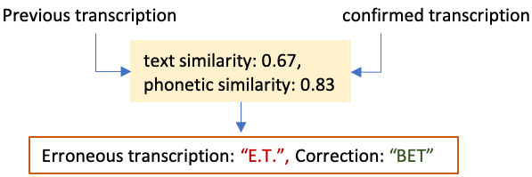
Interaction-based Detection and Annotation
After we confirm the transcription of the last voice query:
- Look at the previous query from the same user to see if it points to a potential system error
time-ordered session events
t
Extract previous
utterance u_{n-1}
Final utterance u_{n}
and subsequent tune
Notes:
If the previous query shares lexical similarity, and there are no following confirming actions, we regard the transcription of the former voice query to have high probability of ASR or some downstream error (Figure 3), thereby calling it a suspicious query. As the final user interaction is assumed to represent the underlying user intent, we hypothesize that it is a correction of the suspicious query.

Slide 12
Evaluation
Utterance-based Detection and Annotation
Data | 474 sessions with 925 utterances on 68 detected erroneous queries
Error detection | Precision: 77.49%
 | Recall: 76.11%
Suggest correction | Accuracy: 69.76%
 | WER would have reduced by 0.907
Interaction-based Detection and Annotation
Data | 225 queries with 15 utterance samples for 15 unique queries
Confirmed transcriptions | Accuracy: 99.60%
 | WER of 0.002
Identify suspicious transcriptions | Accuracy: 87.1.%
Suggest correction | Accuracy: 80.0%
Notes:
We evaluate both utterance-based and interaction-based annotation on thousands of voice queries from real users.
Trained annotators listened to corresponding audios for each transcription and determined whether ASR was correct. If not, the annotator also determined the correct transcription.
Our systems shows strong ability to detect ASR errors, predict corrections and reduce Word error rate after applying the auto-suggest corrections.
Interaction-based approach is able to confirm transcriptions with extreme high accuracy and build good training data for ASR systems

Slide 13
Conclusion
We present an automated annotation system that provides an unsupervised approach to identify erroneous transcriptions and to suggest possible fixes for detected errors.
Our auto-annotated training data reaches an overall word error rate (WER) of 0.002 and we obtained a reduction of 0.907 in WER after applying the auto-suggested fixes.
Our system can be directly applied to improve annotation efficiency and robustness of ASR systems
Notes:
After we confirm the transcription of the last voice query, we also look at the previous query from the same user to see if it points to a potential system error. If this query shares lexical similarity, and there are no following confirming actions, we regard the transcription of the former voice query to have high probability of ASR or some downstream error (Figure 3), thereby calling it a suspicious query. As the final user interaction is assumed to represent the underlying user intent, we hypothesize that it is a correction of the suspicious query.

